Slide 1
Introduction to Computation
Fan Cheng Shanghai Jiao Tong University
http://www.cs.sjtu.edu.cn/~chengfan/
chengfan@sjtu.edu.cn
Autumn, 2022
Notes:
Numbers, floating numbers, string, mathematical expressions, print()

Slide 2
几点意见
进度：正确安装python环境，初步学会使用VSCode/Pycharm建立并运行程序 (参考课程OC的攻略)
计算导论不同于数学、物理等课程
更强调动手，从计算机的角度思考问题
多动手，所有代码敲一遍
万事不决，问编译器(VSCode, Pycharm)
助教
学有余力、课程难度不够？？？(写leetcode.com，从easy开始)
附送100道leetcode练习题，见OC

Slide 3
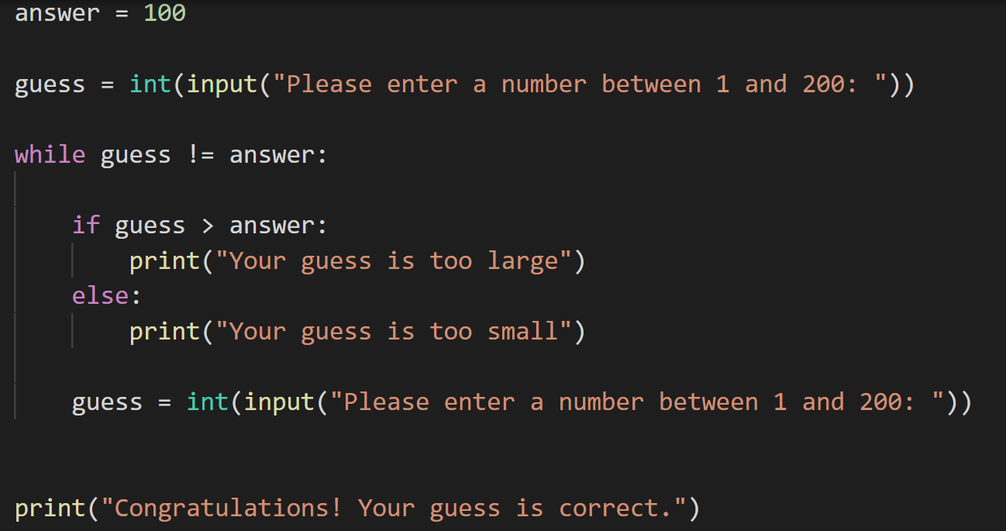
Structure of Program
基本语法
输入、输出
变量定义
条件判断语句
循环
函数
Learn English:
character, word, sentence, passage, section, chapter
字词句段篇章

Slide 4
Outline
Character
Numbers
Strings
Variables

Slide 5
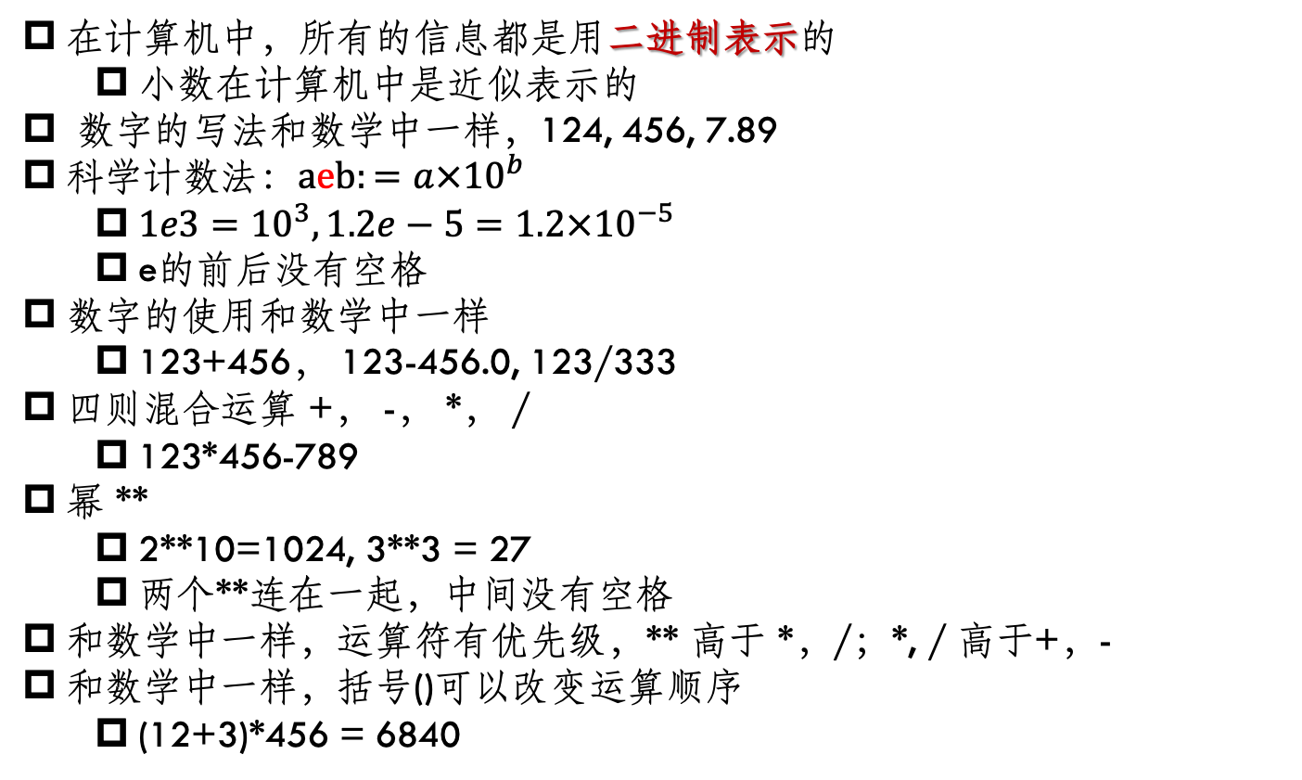
Numbers
在计算机中，所有的信息都是用二进制表示的
小数在计算机中是近似表示的
数字的写法和数学中一样，124, 456, 7.89
科学计数法：$aeb:=a×{10}^{b}$
$1e3={10}^{3}, 1.2e−5=1.2×{10}^{−5}$
e的前后没有空格
数字的使用和数学中一样
123+456， 123-456.0, 123/333
四则混合运算 +， -， *， /
123*456-789
幂 **
2**10=1024, 3**3 = 27
两个**连在一起，中间没有空格
和数学中一样，运算符有优先级，** 高于 *，/；*, / 高于+，-
和数学中一样，括号()可以改变运算顺序
(12+3)*456 = 6840

Slide 6
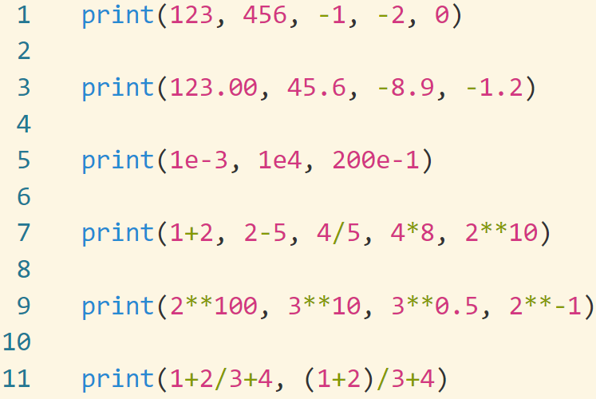
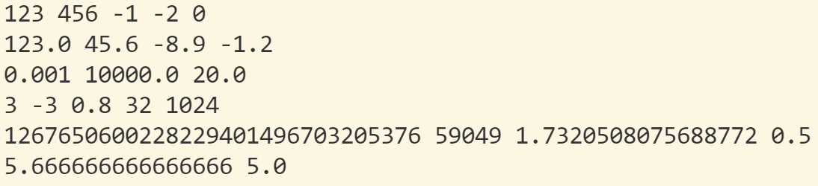
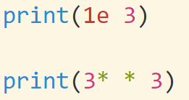
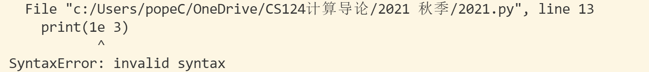
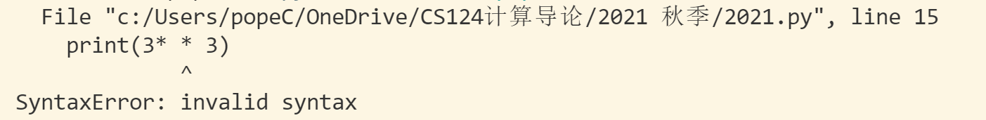
必须严格按照语法

Slide 7
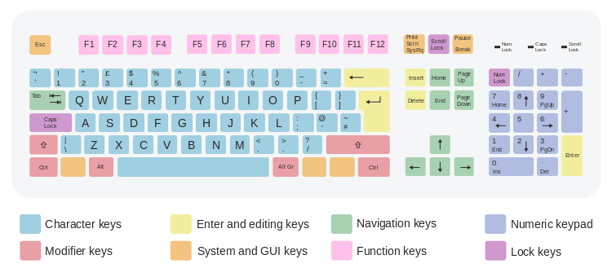
Characters in computers
Digits: 0-9
Letters: a-z, A-Z
+, -, *, /
(), [], {}, !, “,”, ‘,’,
$, @
In standard keyboard, 101-107 keys
Symbols in ‘’ or “” are characters: ‘a’, ‘b’, ‘1’, ‘*’, “a”, “c”, “&”
‘1’ is different from 1.
Computers know only 0 and 1. All the characters are stored in 0’s and 1’s .
For example,
‘a’ is denoted by 1100001
‘1’ is denoted by 110001
In order to exchange information between computers, a standard is necessary. ASCII

Slide 8
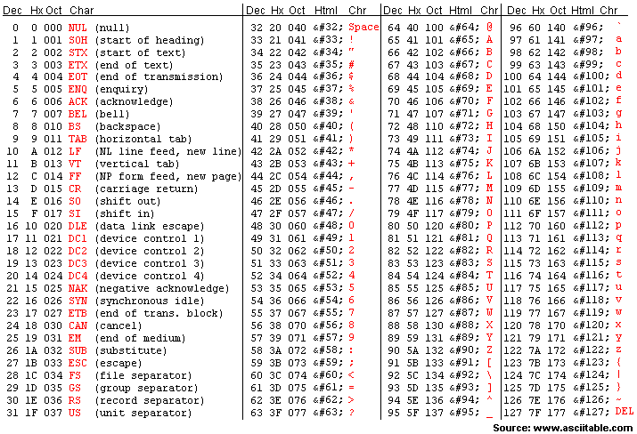
ASCII
ASCII, abbreviated from American Standard Code for Information Interchange, is a character encoding standard for electronic communication.
ASCII codes represent text in computers, telecommunications equipment, and other devices.
Most modern character-encoding schemes are based on ASCII, although they support many additional characters.
Dec: 10进制
Hx：16进制
Oct：8进制
Remember some frequently used characters; e.g., ‘a’, ‘A’, ‘0’
Keep in mind: ‘a’—’z’, ‘A’—’Z’, ’0’—’9’ are continuous.

Slide 9


print()
print在字面上：打印
从打印的角度理解：光标在纸面上移动，从左往右，一行一行
可以换行: enter
可以回退: backspace
print(123), print(‘123’)效果一样
Enter: 换行，另起一行
Backspace: 回退

Slide 10
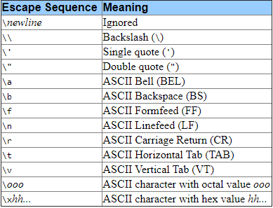
Escape character
字母、数字，数学运算符号都是直接表示：’a’, ‘Z’, ‘0’, ‘9’, ‘+’, ‘-’, ‘*’, ‘/’
如何将键盘上一些特殊的键位写成字符？
例如：回车、换行、制表符
思路：用两个字符的组合来表示，以\(反斜线)开始
\n: new line, \t: tab, \\: \, \a: bell
Characters with special meaning, called escape characters (转义字符)
特别注意：当一个字符以\ 开始的时候，要注意这不是普通字符，而是转义字符，要结合后面的字符一起判断。否则是语法错误
\\: 表示反斜线\
\r: 回到当前行的开始
\b: backspace 光标回退一位
\a：铃声（控制台）
\n: 换行，另起一行
\f: 光标换到下一行的相同位置
\和/是不同的

Slide 11
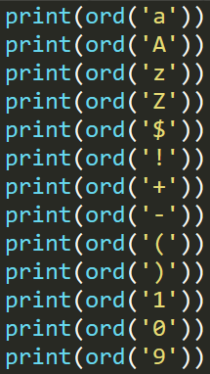

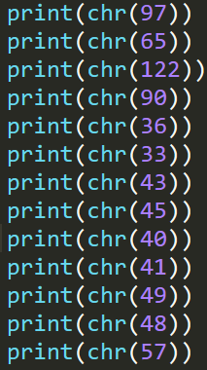
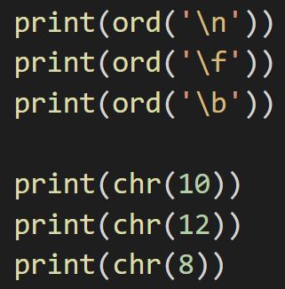

Character and its ASCII
字符和其对应的二进制表示的相互转换
ord() and chr() : Two useful function for dealing with ASCII.
ord(x): return the corresponding ASCII of character x
chr(x): return the corresponding character by its ASCII
Functions (函数): print(), chr(), ord()
Only 255 characters in ASCII. No 中文
Unicode is more widely used in practice.
ASCII is a subset of Unicode
Notes:
20 mins

Slide 12
Python data types
Python数据类型：物以类聚、人以群分
Before, we have used numbers and words like 123+456, “Shanghai”
In Python, we have two basic data types: number and string
Numbers can be integer, float, or Complex number
Integer can be binary, octal and Hexadecimal

Slide 13

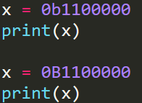
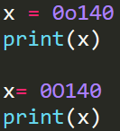
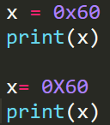



Integer
In default, integers are based on 10. For example 96.
If we want to denote numbers in bin, oct and hex, prefix is needed
Binary: 0b (0B) 96 = 0b1100000 or 0B1100000
Octal: 0o (0O) 96 = 0o140 or 0O140
Hexadecimal: 0x (0X) 96 = 0x60 or 0X60.
10,11,…,15 are ‘ABCDEF’ or ‘abcdef’
8 = 0x8, 9 = 0x9, 10= 0xA or 0xa, …, 15 = 0xF or 0xf.
In Python 3, there is effectively no limit to how long an integer value can be.
Try to test x = 127 yourself
How to transfer a number from binary to oct or hex? 3 by 3! 4 by 4!
127 = 0b1 111 111 = 0o177
= 0b 111 1111 = 0x 7F
The best way to learn a programing language is to practise it yourself
Notes:
20 mins

Slide 14
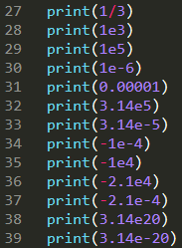
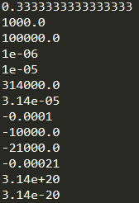

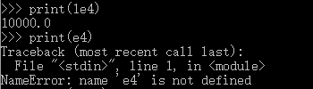

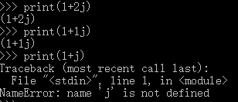
Floating-Point Number (浮点数)
In mathematics, we have rational number and irrational number
In python, we call it floating-point number (浮点数，小数)
Floating number can be written as:
4.2, 3.1415926, 10000.431
1e-8, 3e4 (1 and 3 cannot be missed)
Floating numbers are not accurate. Integers are always accurate. Rounding error!
Complex number are denoted by a + b j, a is the real part and b is the imaginary part.
When b=1, 1 cannot be missed

Slide 15



Floating Accuracy (浮点数不准确)
尽量避免使用浮点数，尽可能使用整数

Slide 16
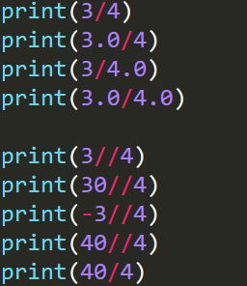
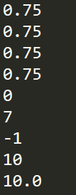
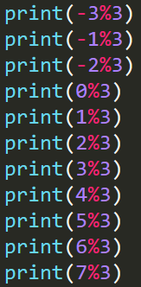

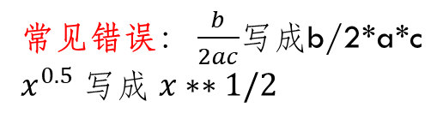
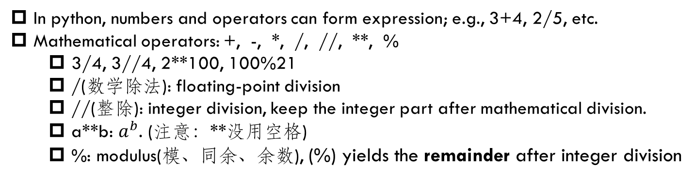
常见错误： $\frac{b}{2ac}$写成b/2*a*c
$x^{0.5}$写成 $x∗∗1/2$
Expressions on numbers
In python, numbers and operators can form expression; e.g., 3+4, 2/5, etc.
Mathematical operators: +, -, *, /, //, **, %
3/4, 3//4, 2**100, 100%21
/(数学除法): floating-point division
//(整除): integer division, keep the integer part after mathematical division.
a**b: $a^{b}$. (注意：**没用空格)
%: modulus(模、同余、余数), (%) yields the remainder after integer division
In python, // and / are quite different from other languages like c/c++.
Notes:
Open the first two programs

Slide 17
Remainder 余数
计算 ${123456789}^{987654321}$除以2的余数
定义：x=a (mod n)表示x同余a，除数(模)是n
判断两个数同余，不能用a==b, 要用(a-b)%n==0
例子 7=3 (mod 4), 9=1 (mod 2), 1234567=25 (mod 111)
7=-1(mod 4), 8=-2 (mod 10)
基本规律 a=b, c=d (mod n), 那么
a+b = c+d, a-b = c-d, a*b = c*d
在计算大整数的余数的时候，用同余运算来处理，计算量更小。 1234567=25 (mod 111)
1234567*1234567=25*25=70 (mod 111)
不用直接计算 1234567*1234567的值
例子： 1234567654321 ** 100 = 1 ** 100 = 1 (mod 111)

Slide 18
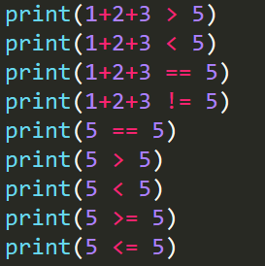
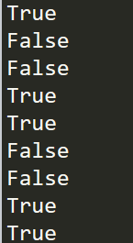
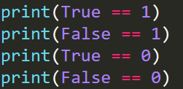
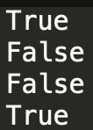
Logic expression (逻辑表达式)
Logic operators: >, <, ==, >=, <=, !=
3>2, 1<-4, 7>=100, 45<=53
>, <, >=, <= are just the normal mathematical relation
==: x==y, x is equal to y
!=: x!=y, x is not equal to y
Logic operator will return True or False, if the expression is satisfied or not
In python, True is 1 and False is 0
Q: True * 12?
Notes:
Open the first two programs

Slide 19

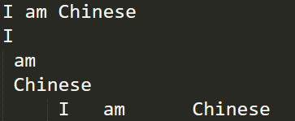

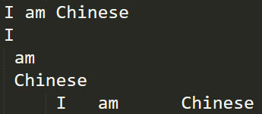


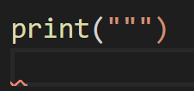
String
A string is a sequence of characters, enclosed by single quotes and double quotes
Single quotes and double quotes are identical
‘abc’ ==“abc”, “SJTU” ==‘SJTU’
注意：在string中，’或’’会和前面最近的一个’或’’匹配

Slide 20
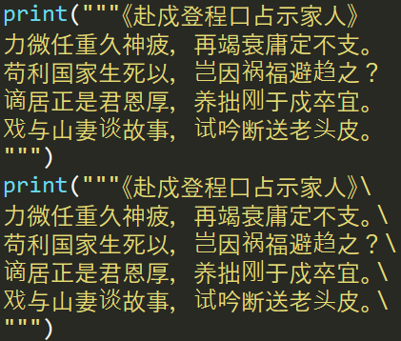
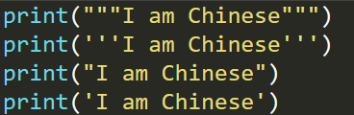
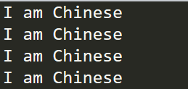
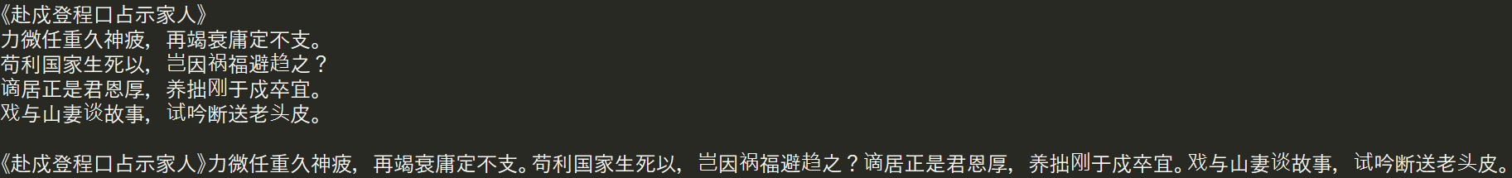
String: triple quotes
String literals can span multiple lines. One way is using triple-quotes: """...""" or '''...'''. End of lines are automatically included in the string, but it’s possible to prevent this by adding a \ at the end of the line.
Triple quotes are useful for large chunks of text in program code spreading several lines.

Slide 21
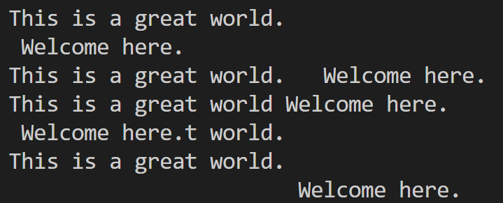
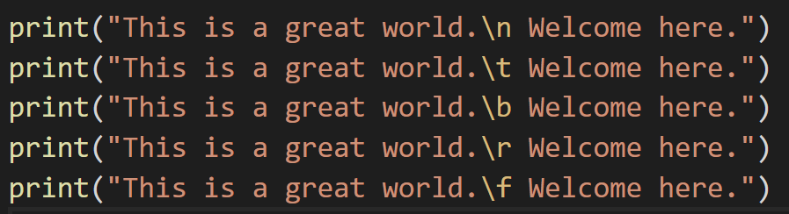
String with Escape character
\出现的时候就是转义字符
系统会把\后面的几个字符和\合起来理解，而不是单独考虑
\”, \’ 都是转移字符
\r: 回到当前行的开始
\b: backspace 光标回退一位
\a：铃声 （在控制台下测试）
\n: 换行，另起一行
\f: 光标换到下一行的相同位置
记住：\n,\b,\t

Slide 22

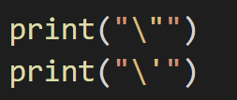
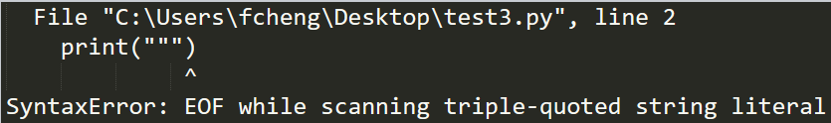


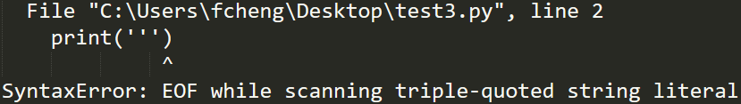

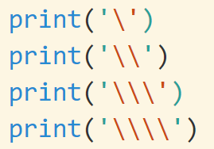


String with escape characters
“ and ‘ have been used by system. What should we do if we want to print “ or ‘?
How to output \: print(‘\\’)
思考
语法错误

Slide 23
String with escape characters
Python中如何取消转义字符？
Add “r” before string can be used to stop escape character.
重要的事情说三遍
Escape character
escape character
escape character

Slide 24
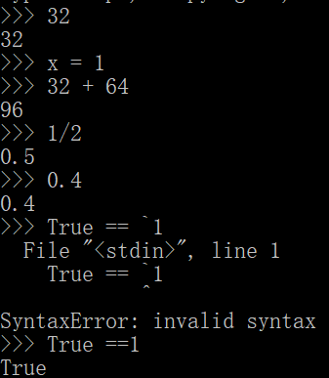
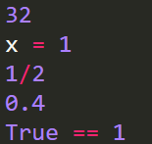
Python console and IDE
In the console (interpreter) that the python 3.x package attached, when you type sth. in the console, you will get an output after you type newline, even if you don’t use print(). However, in python IDE, like PyCharm, that is not the same. In PyCharm, you won’t get an output unless you use print()
The reason is, Python console is designed to help you learn python grammars. It will automatically output the value of the input for convenience. This behavior is not defined by Python Language and it is controlled by Python console. PyCharm/VS Code will operate loyally as python Language defined
In VsCode/PyCharm, you won’t get any output since you don’t use print().

Slide 25


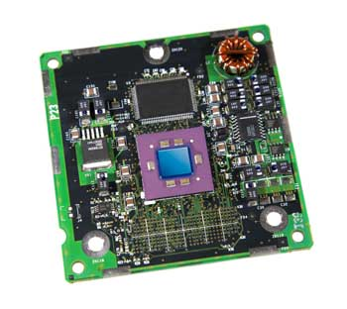
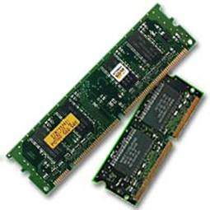

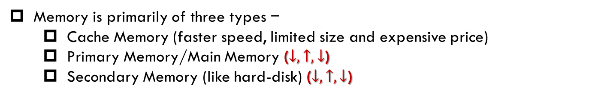
Types of Storage
Memory is primarily of three types −
Cache Memory (faster speed, limited size and expensive price)
Primary Memory/Main Memory ($↓,↑,↓$)
Secondary Memory (like hard-disk) ($↓,↑,↓$)
速度越来越快
价格越来越便宜
容量越来越大
高速缓存: 8M
主内存: 16G
硬盘：2T
磁带
U盘：64G
The faster, the more expensive
The cheaper, the larger

Slide 26
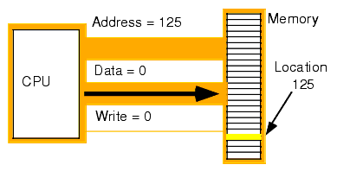
Memory (内存)
A memory is just like a human brain: store data and instructions.
Computer memory is the storage space in the computer, where data is to be processed and instructions required for processing are stored
The memory is divided into large number of small parts called cells
Each location or cell has a unique address
https://www.tutorialspoint.com/computer_fundamentals/computer_memory.htm
Some cells are readable and some are writeable.

Slide 27
Memory Abstraction (内存想象示意图)
Memory are divided into cells, each of which has a unique address.
Each cell : unique address
用一个大方格（作文本）来表示一个内存
每个小方格可以用第i行，第j列作为它的地址 (i,j)
每个小方格可以存储一个信息
每个小方格的信息可以根据地址来访问：读 或者 写
后面写的信息会把前面写的信息覆盖掉
 | 苟 | 利 | 国 | 家 | 生 | 死 | 以
 |  | 1 | 2 | 3
 |  |  | + | -
 |  | S | J | T | U

Slide 28
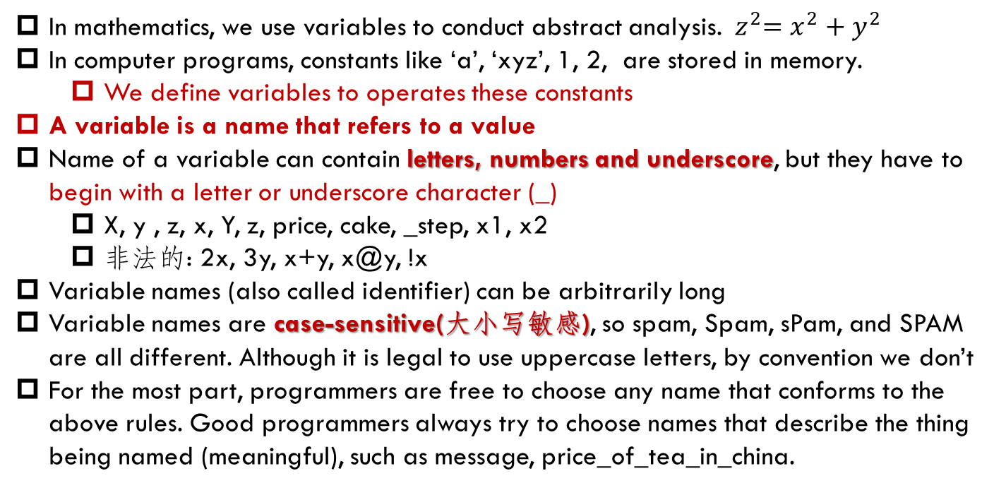
Variable in python
In mathematics, we use variables to conduct abstract analysis. ${ z}^{2}=x^{2}+y^{2}$
In computer programs, constants like ‘a’, ‘xyz’, 1, 2, are stored in memory.
We define variables to operates these constants
A variable is a name that refers to a value
Name of a variable can contain letters, numbers and underscore, but they have to begin with a letter or underscore character (_)
X, y , z, x, Y, z, price, cake, _step, x1, x2
非法的: 2x, 3y, x+y, x@y, !x
Variable names (also called identifier) can be arbitrarily long
Variable names are case-sensitive(大小写敏感), so spam, Spam, sPam, and SPAM are all different. Although it is legal to use uppercase letters, by convention we don’t
For the most part, programmers are free to choose any name that conforms to the above rules. Good programmers always try to choose names that describe the thing being named (meaningful), such as message, price_of_tea_in_china.

Slide 29
Variable name: Keywords
Keywords (also called reserved words) define the language’s rules and structure, and they cannot be used as variable names. Python has thirty-five keywords:
False await else import pass
None break except in raise
True class finally is return
and continue for lambda try
as def from nonlocal while
assert del global not with
async elif if or yield
古代皇帝避讳
用关键词作为变量名会报错

Slide 30
Use a variable
Variables are created when they are assigned (=)
year = 2018 (assignment statement, 赋值语句)
month = “September”
price = 3.81
The type of the variable is determined by Python
year = 2018 year is int
month = “September” month is string
price = 3.81 price is float
A variable can be reassigned (重新赋值) to whatever, whenever
price = 3.4 price is float
price = 2 price is int
price = “hello world” price is string
my_price = “hello world” my_price and price are the same
特别注意
1. 尽量用英文来定义变量，不要用拼音和汉字
2. 不要和系统抢变量名, 譬如print
3. 文件名也要用变量名的规则来定义: 字母、数字、下划线，xxx.py

Slide 31
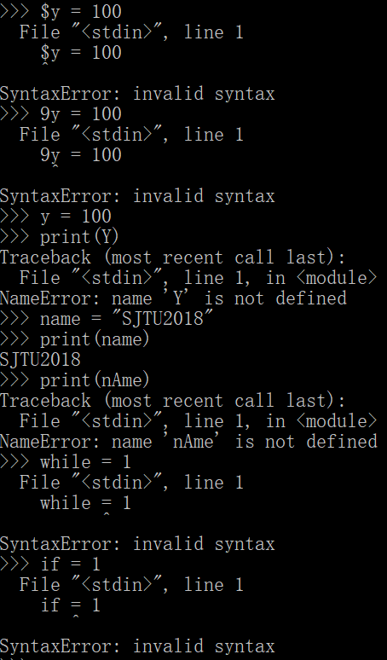


Variable Example
_, digitals, letters and keywords

Slide 32






type() and id()
type(x): will return the type of variable x
type(123)
type(12.3)
type(“Hello world”)
id(x): will return the address of variable x
id是由系统决定的，结果可能不同

Slide 33






Variable expressions
Python中基本的表达式和数学中一样
Priority of operators: *, /, // are higher than +, -. () is the highest
Use “()” is you are unsure of the order
最常见的逻辑错误

Slide 34




Common Errors
Python中语句都要顶格写，开头不能任意加空格
转变数学思维
$$x=\frac{−b+\sqrt{b^{2}−4ac}}{2a}$$

Slide 35
Variable in memory
A variable is a name that refers to a value in the memory
Every variable has a type, a size, a value and a location in the computer’s memory
size: the size of memory to store the value
A state diagram (状态图) can be used for representing variable’s state including name, type, size and value
reassigned (重新赋值): 改变变量的指向
 | 1 |  | 2 |  | 1 | . | 1
2
 |  | 3 | . | 1 | 4
 |  |  | P | y | t | h | o
n
x 1
y 2
price 1.12
pi 3.14
name “Python”

